Slide 1


Innovation and Asset Protection
June 2021

Slide 2
Confidentiality Statement
The reader of this document hereby acknowledges that the information provided is completely confidential and therefore the reader agrees not to disclose information from this document without the express written consent of iM8 Data Limited It is also acknowledged by the reader that the information to be furnished in this document is in all aspects confidential in nature, other than information that is in the public domain through other means, and that any disclosure or use of the same by the reader may cause serious harm and or damage to iM8 Data Limited Upon request this document will be immediately returned to iM8 Data Limited
All information contained in this document is © iM8 Data Limited 2021

Slide 3
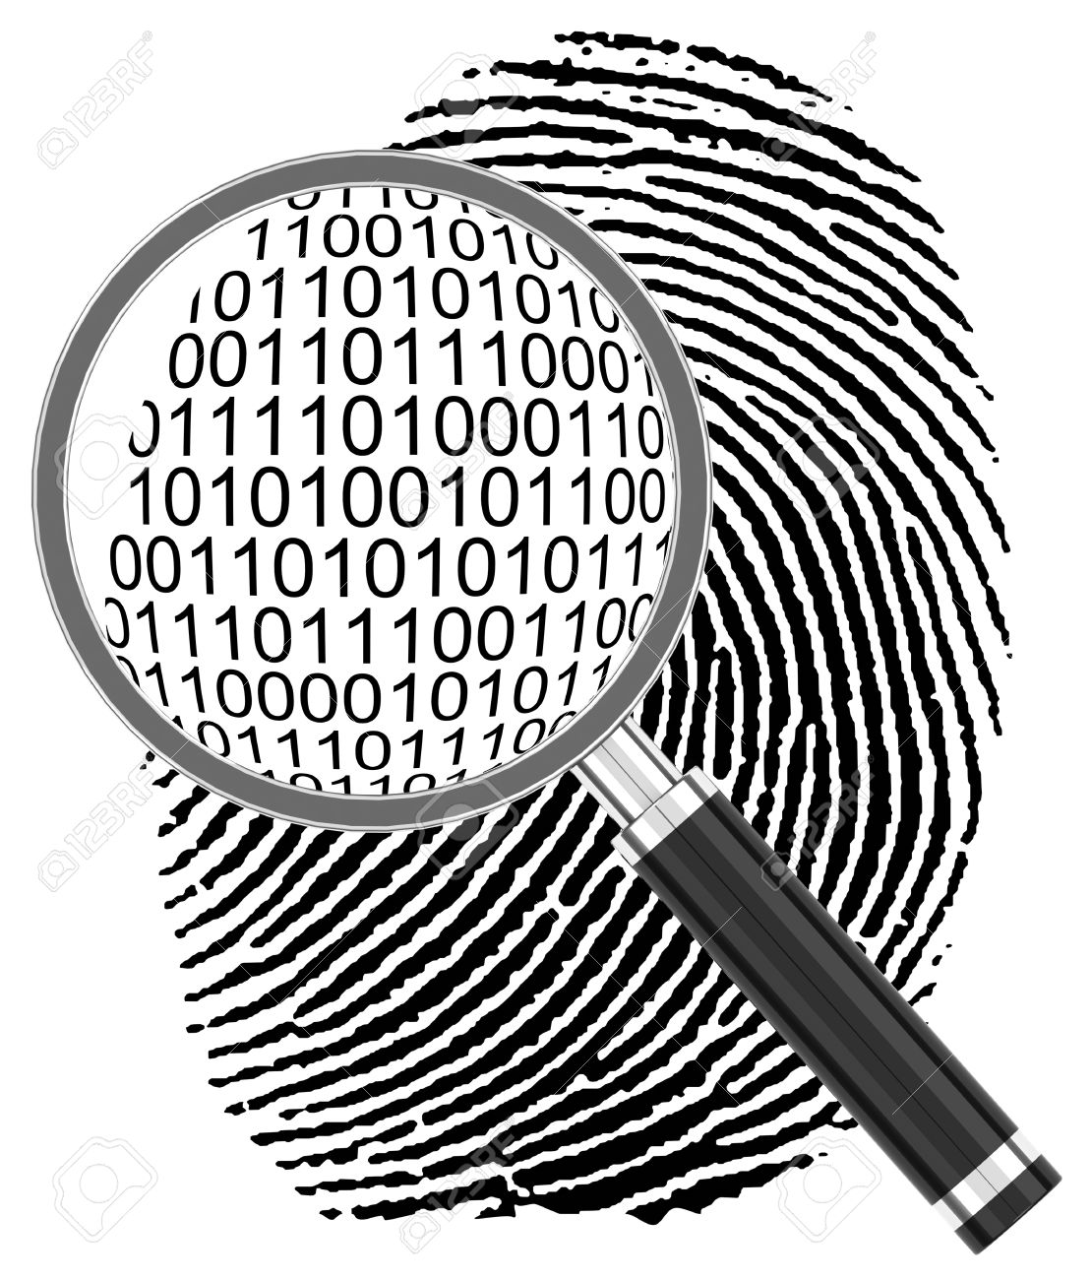
It started with a QR code…
iM8 is a comprehensive app and blockchain based authentication, verification and compliance ecosystem

Slide 4
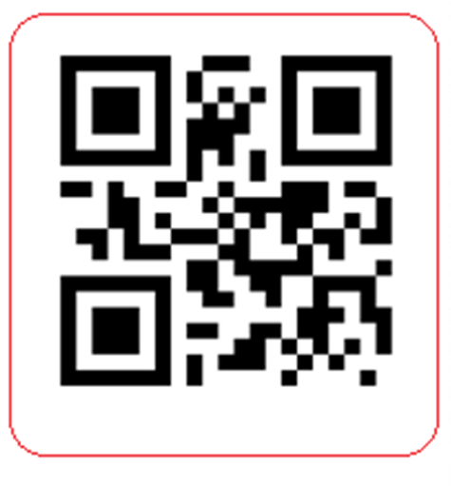
Blockchain Guaranteed Traceability Authenticity & Compliance

Slide 5
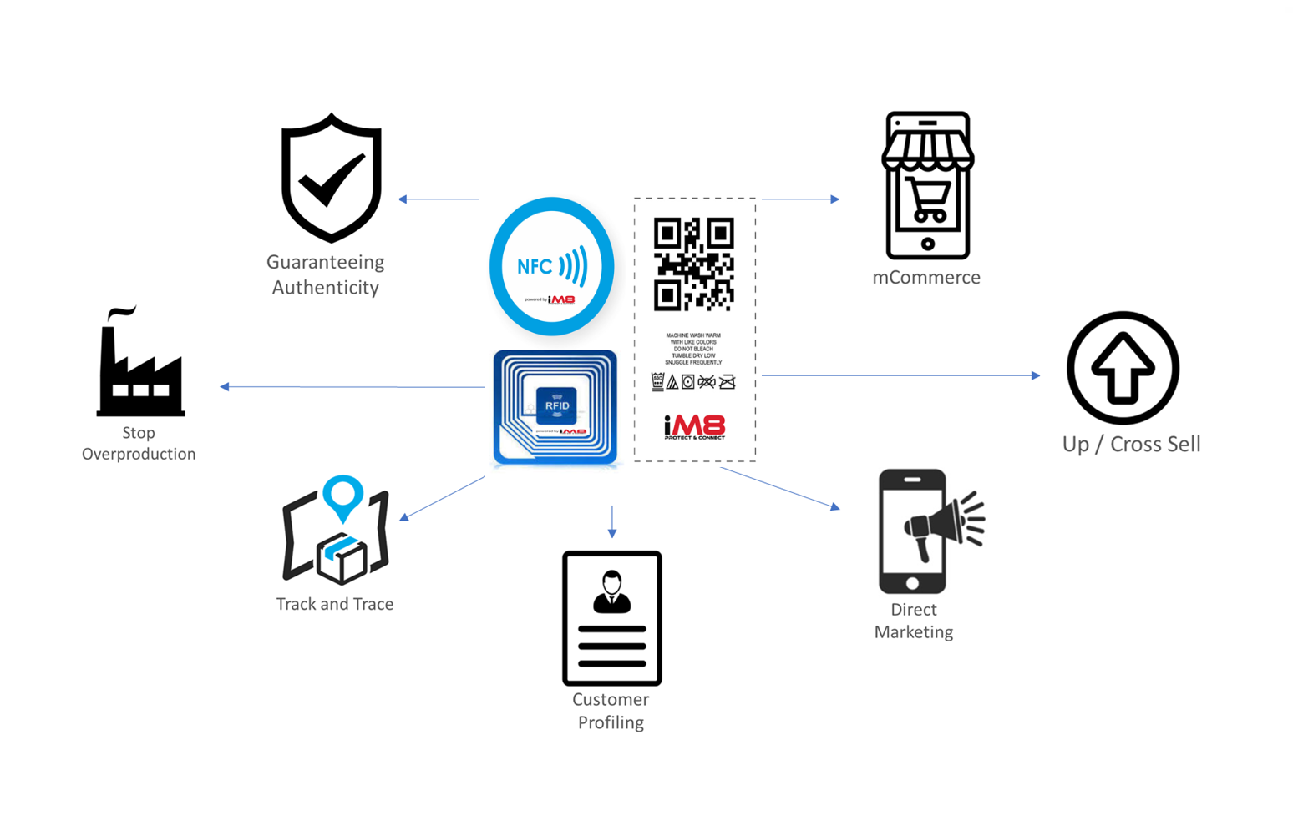
Functionality Overview

Slide 6
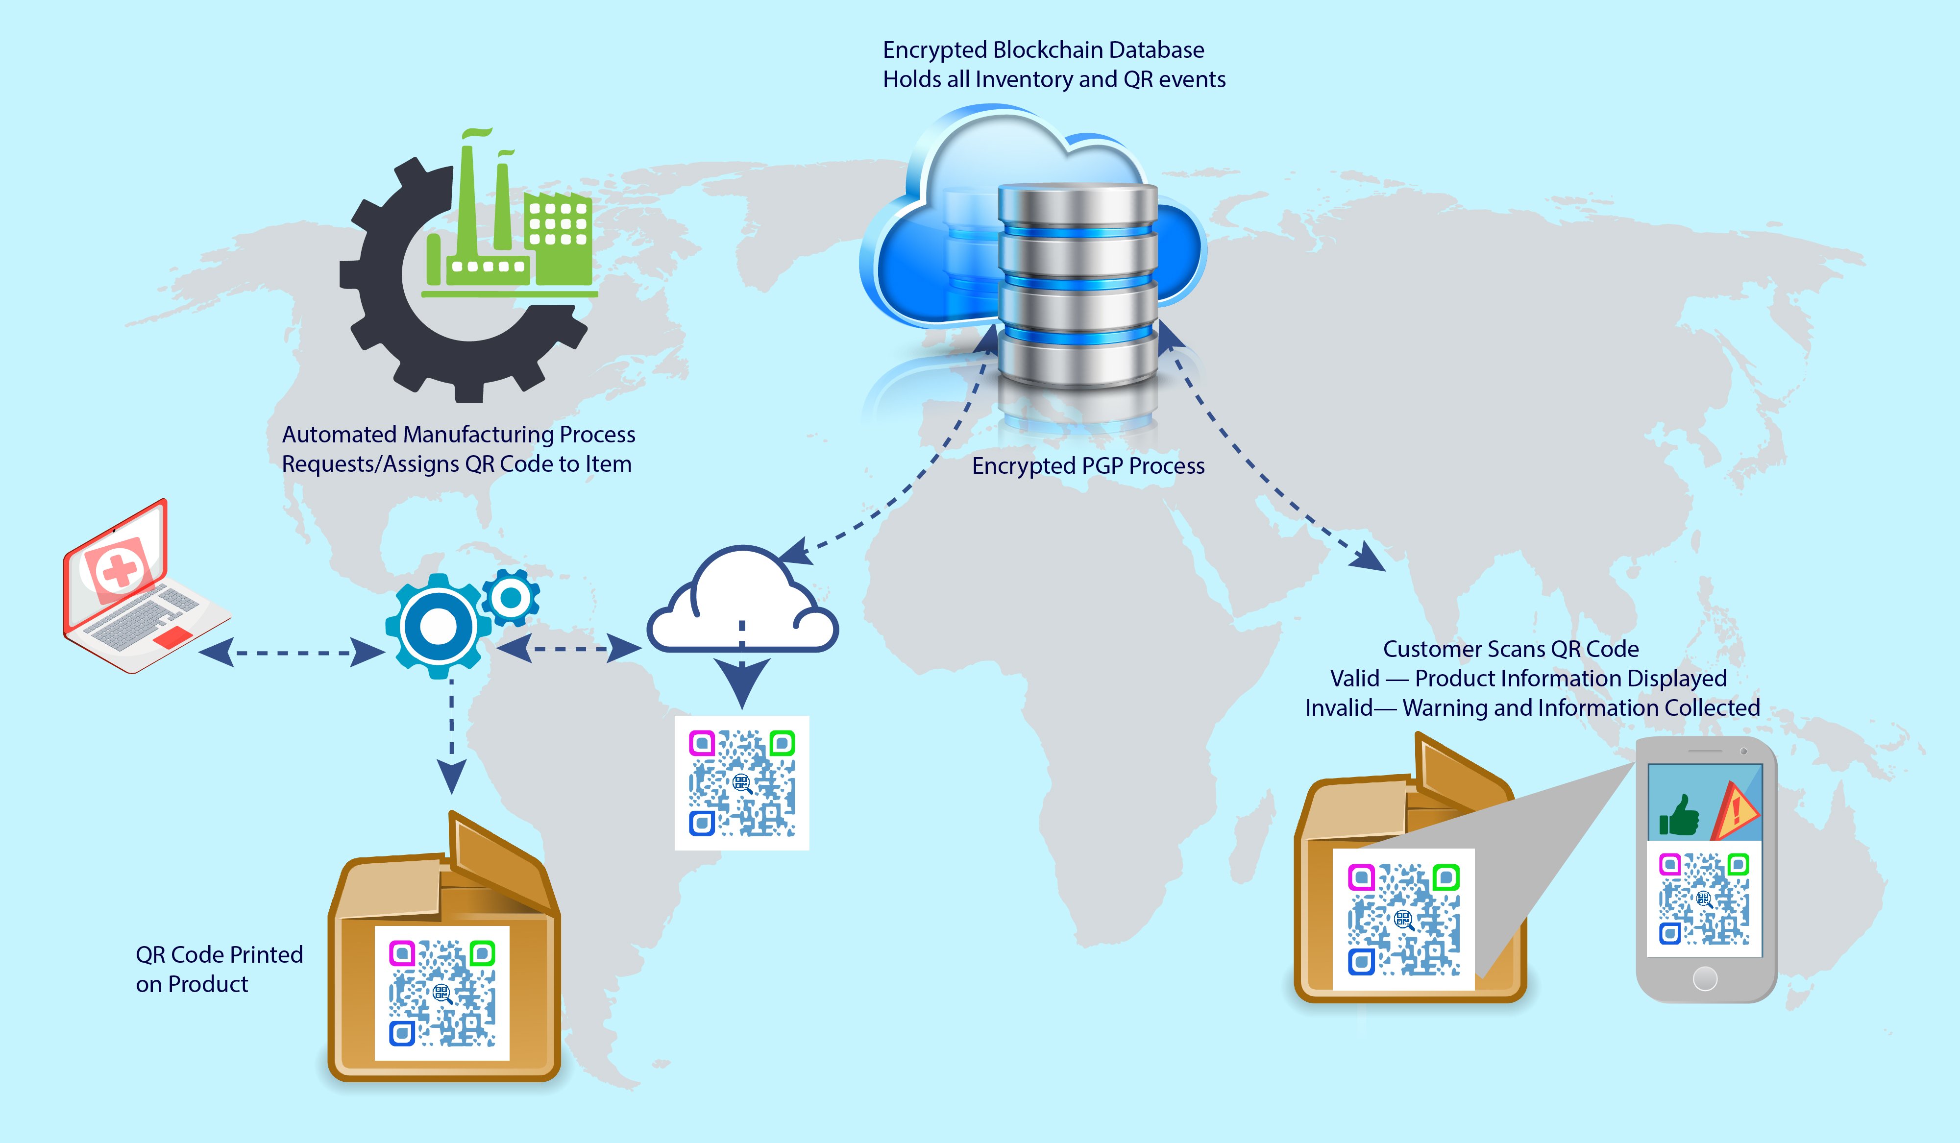
Process Overview

Slide 7
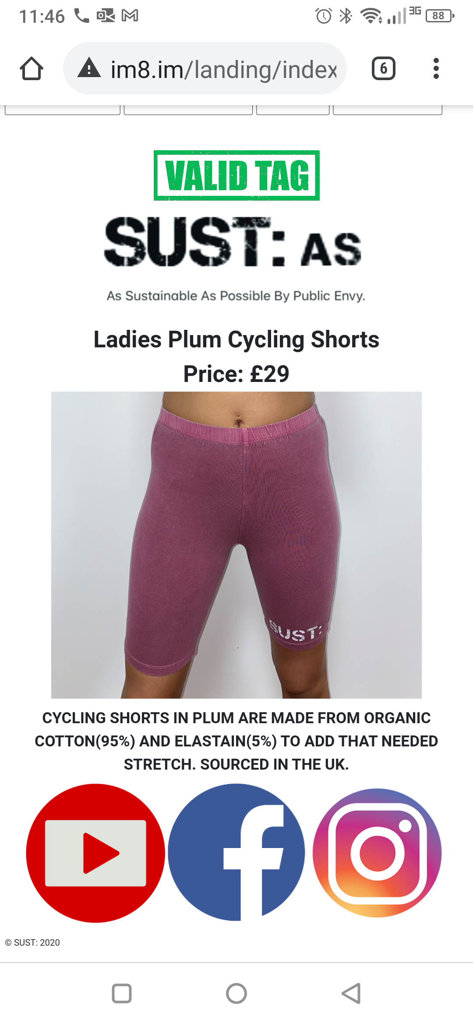
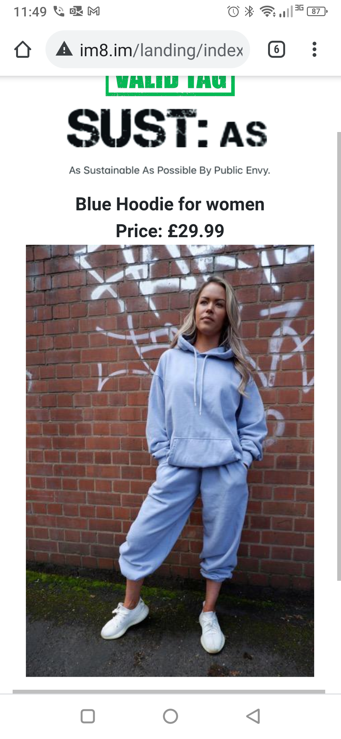
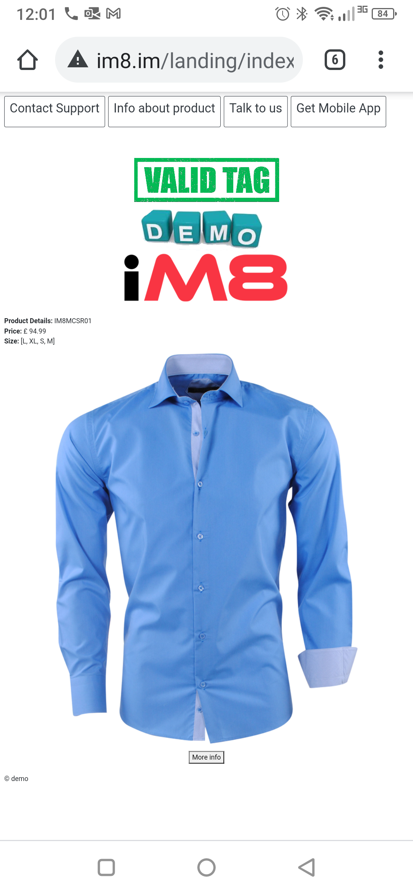
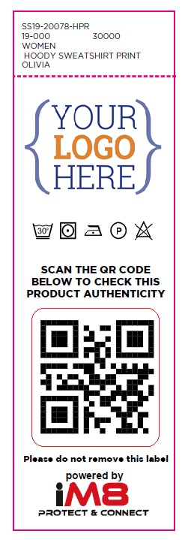
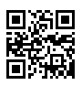
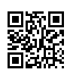
Textile Industry

Slide 8
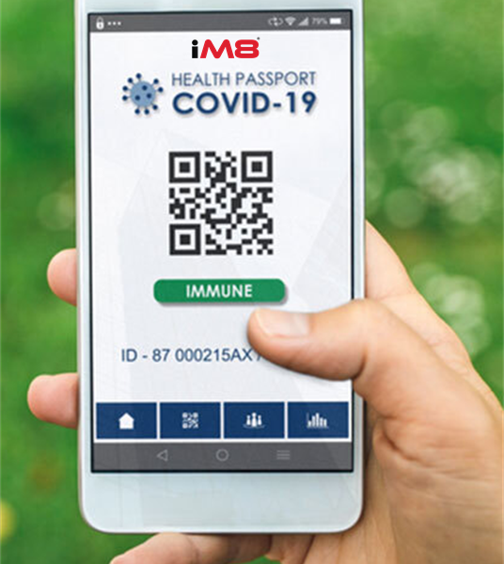
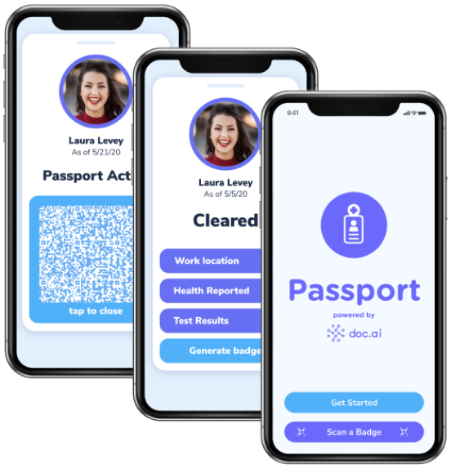
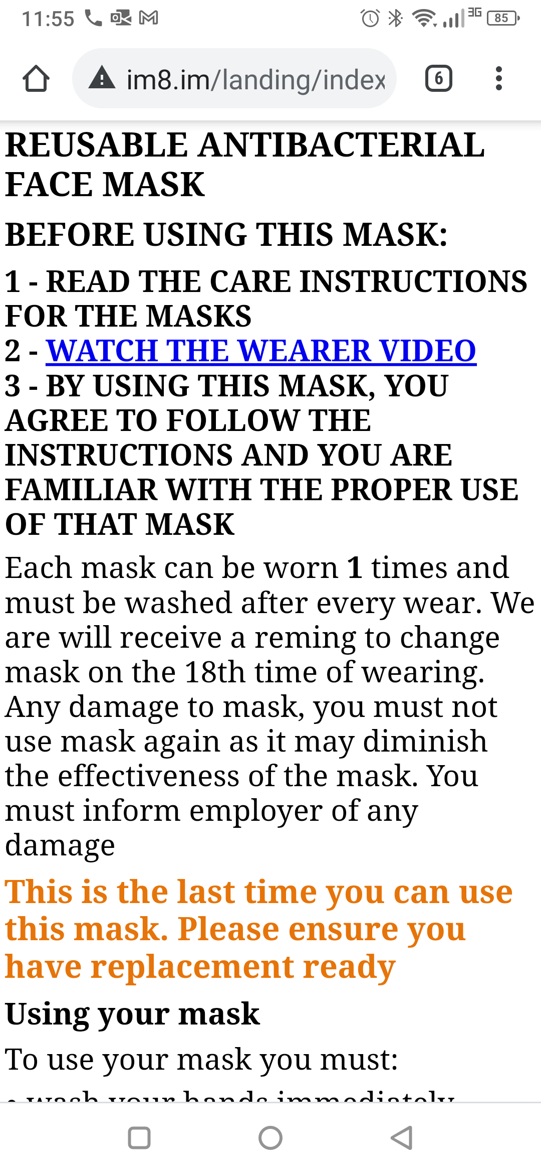
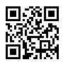

Reusable Face Masks & Personal Health Dashboard

Slide 9
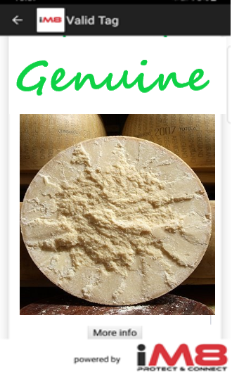
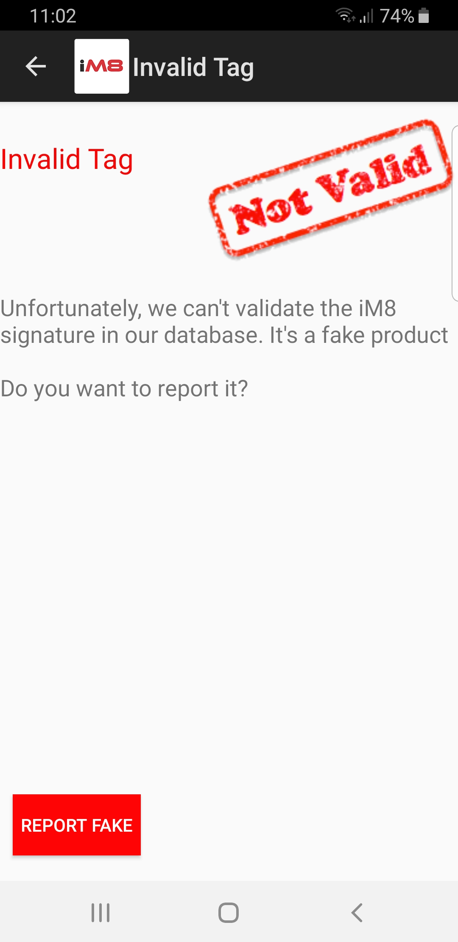
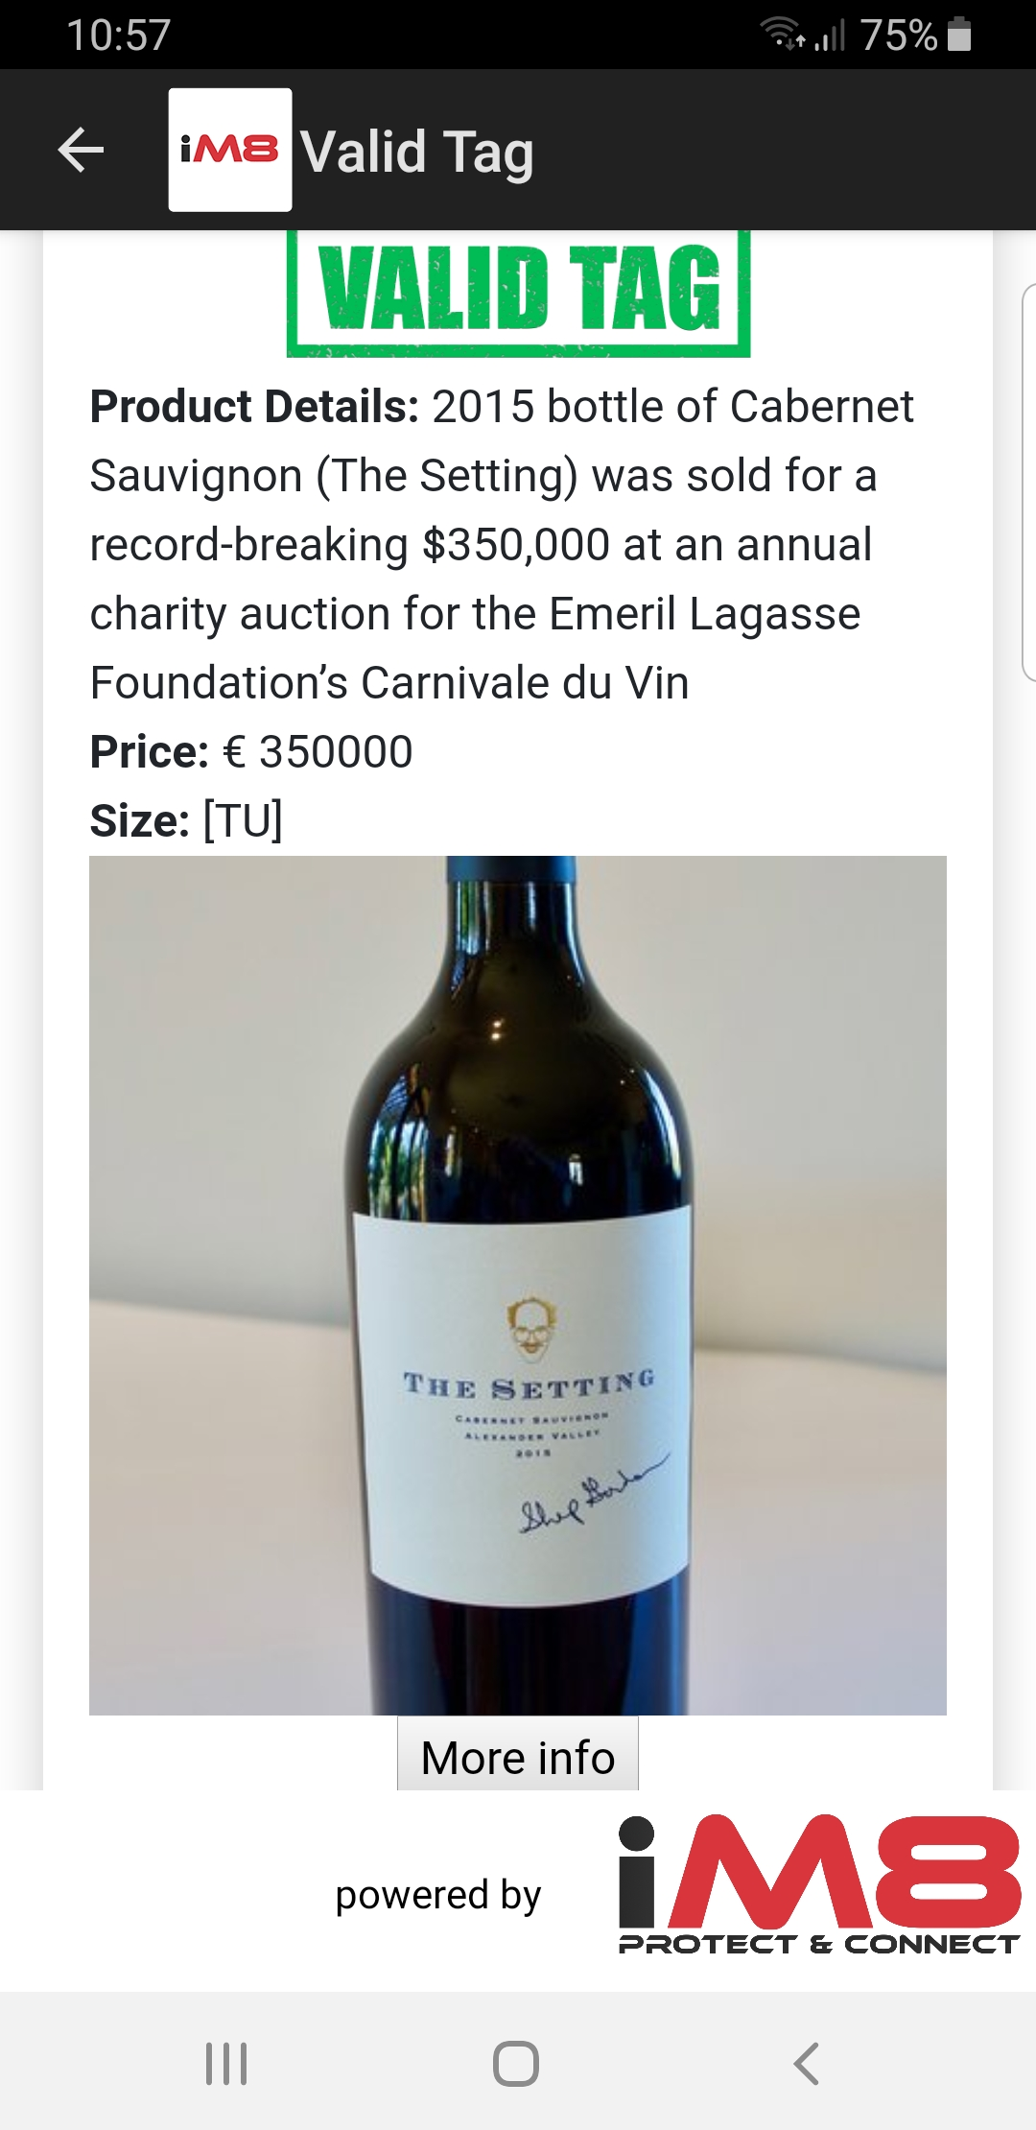
Premium Food and Beverage

Slide 10
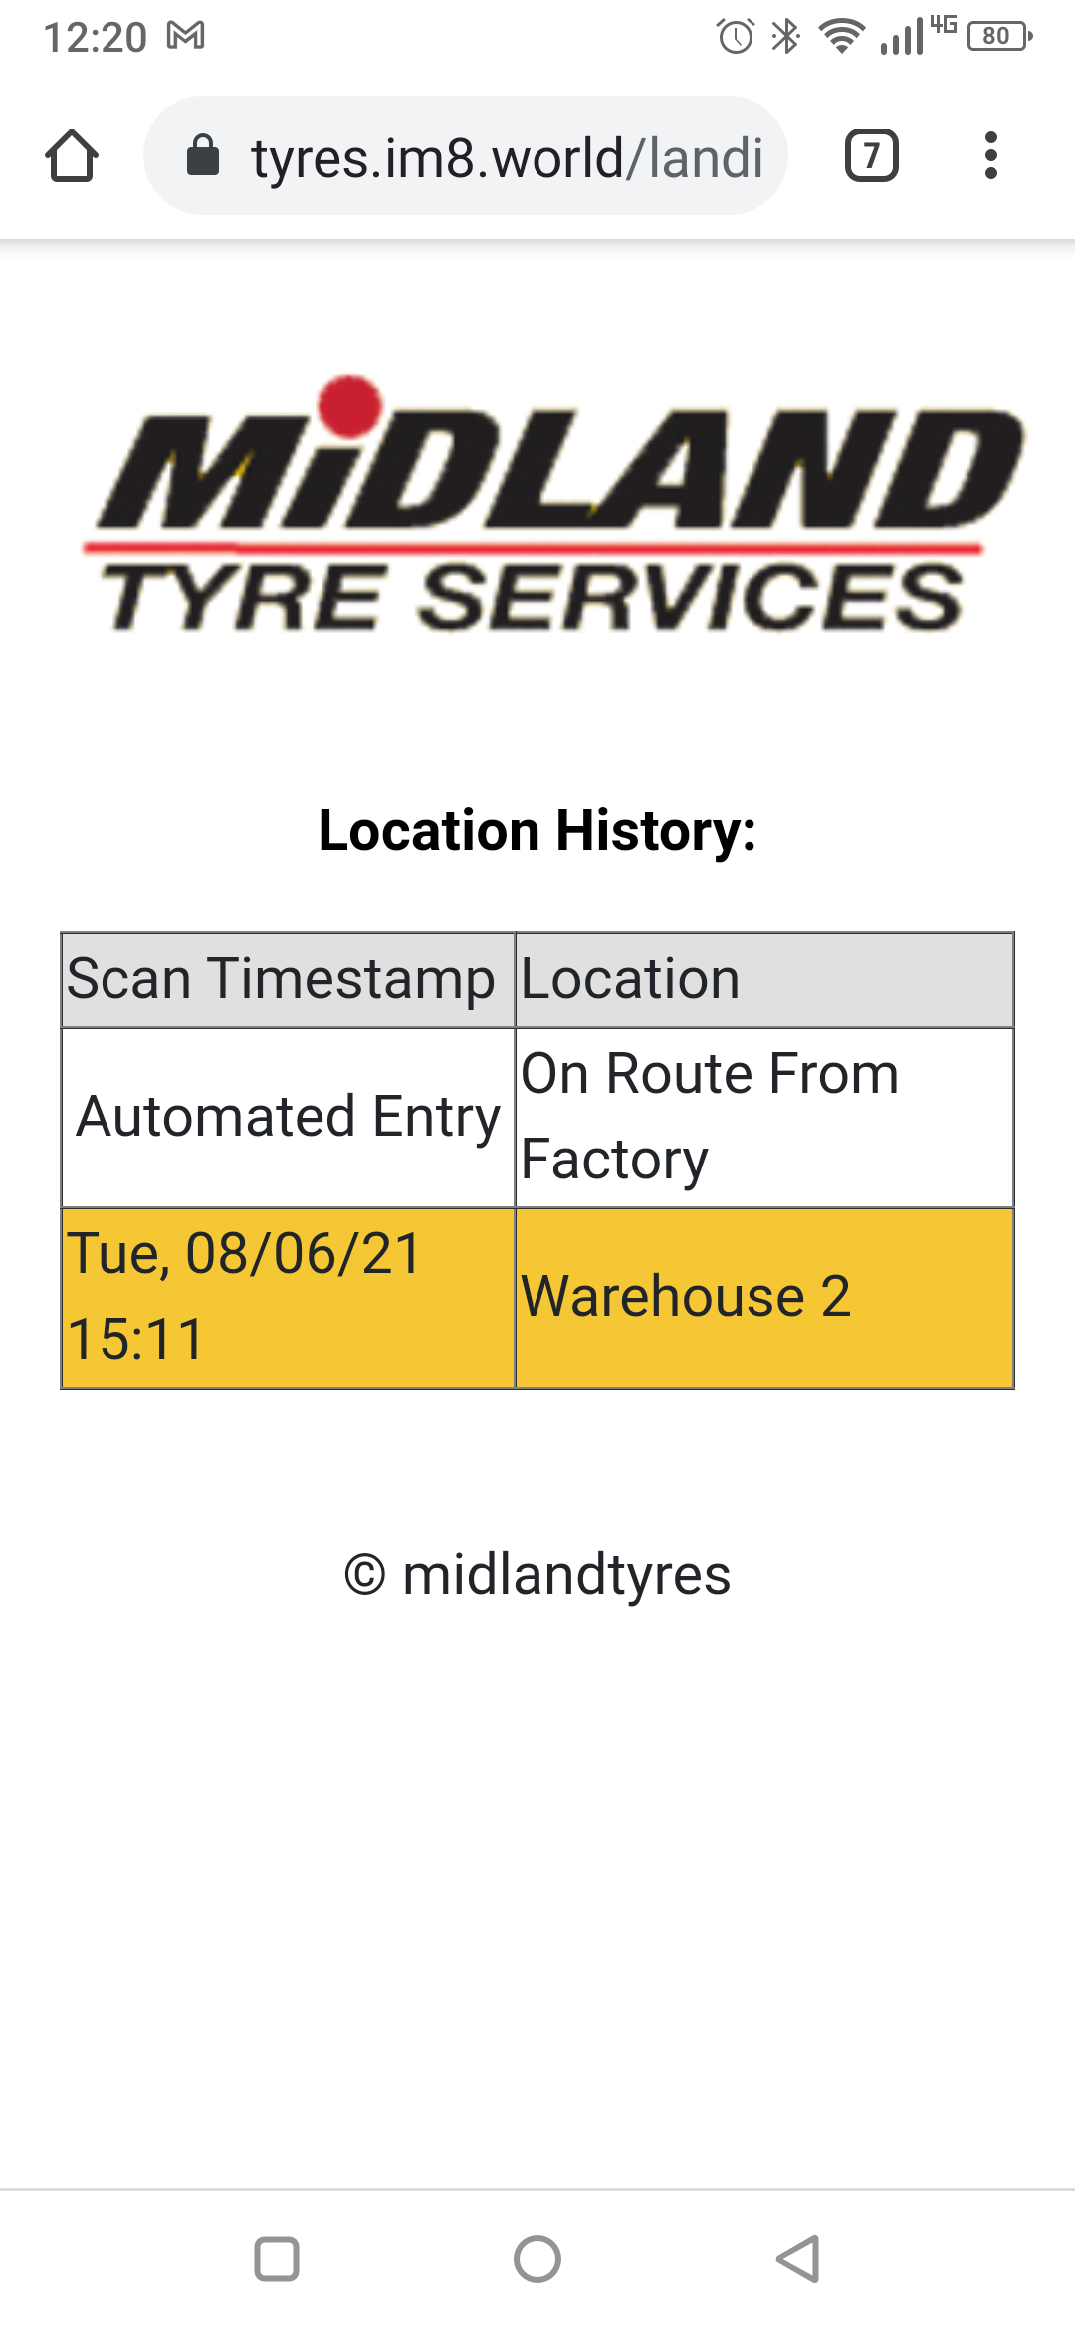
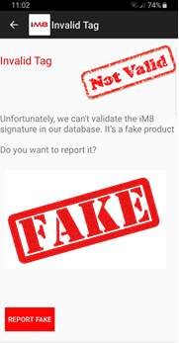
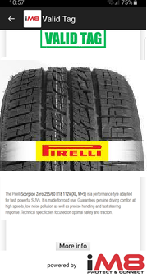
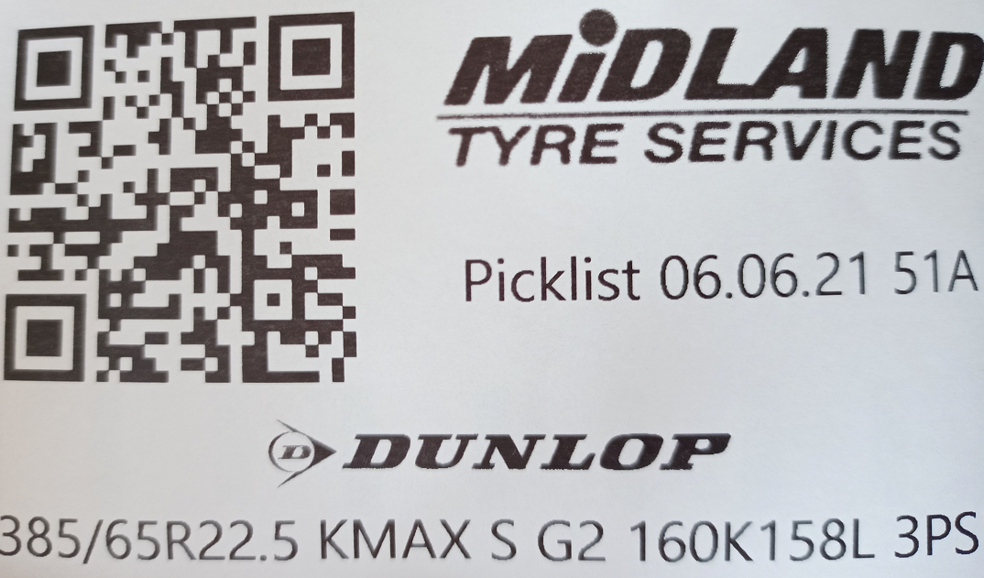
Automotive and Logistics

Slide 11


Connected Auto Dealership

Slide 12
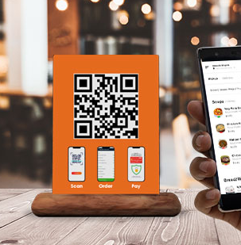
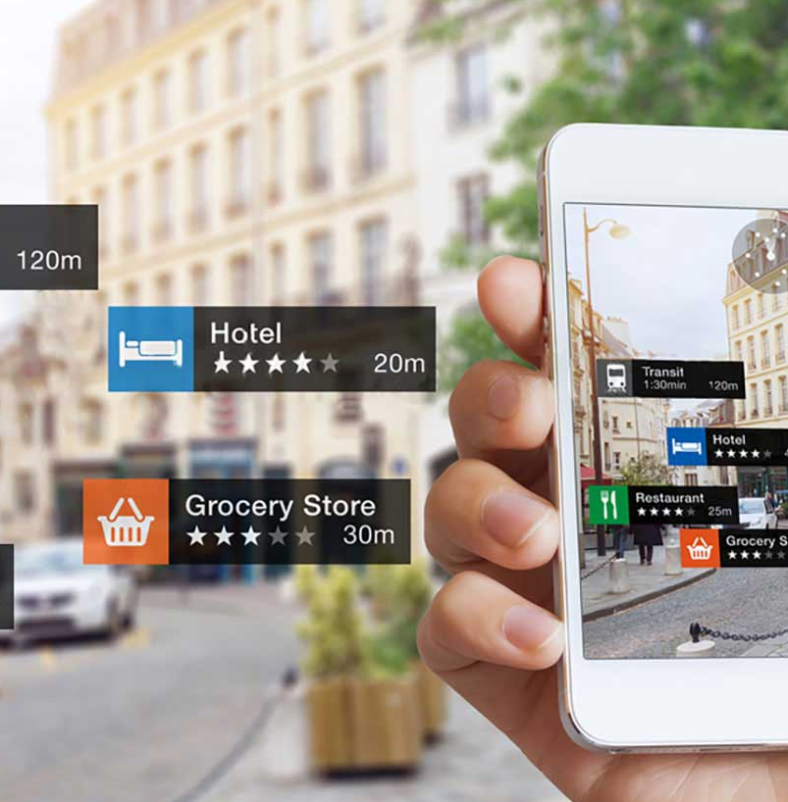
Hospitality
Digitise your business
Customer interaction, enabled by iM8 QR codes
Drive advertising and make the guest experience more effective
Capture guest activity data to enhance profiling and deliver more effective marketing campaigns

Slide 13
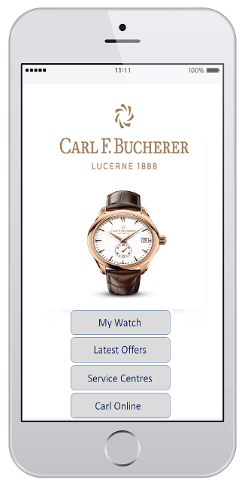
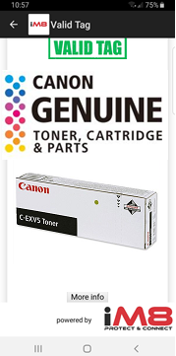
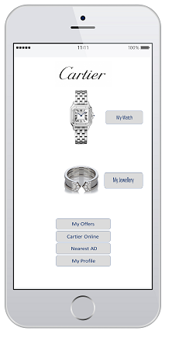
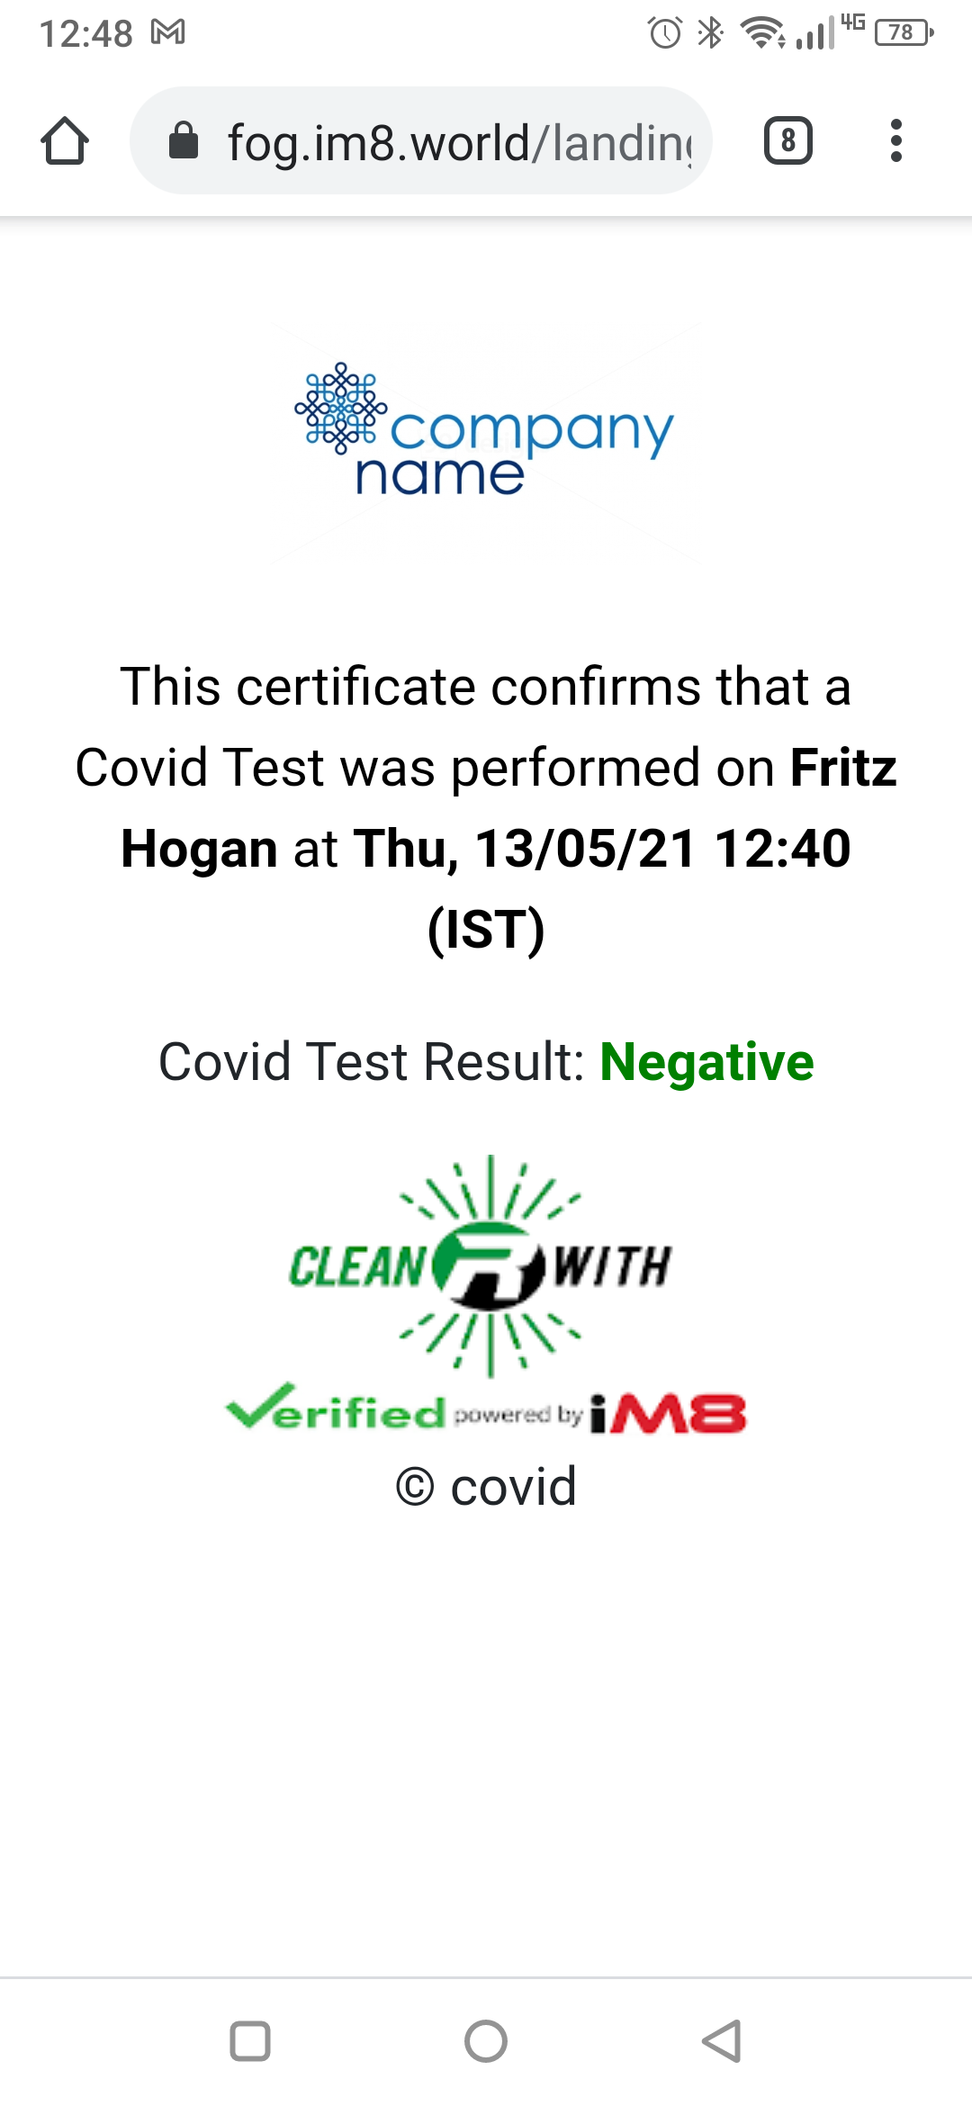
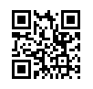
Other Products

Slide 14

The iM8 Blockchain
The iM8 Blockchain utilises the IBM Hyperledger Fabric Blockchain Ledger Architecture
This architecture is an open source platform created by IBM to encourage the use of Blockchain solution in businesses and to develop Blockchain technology for wider industry

Slide 15

© iM8 Data Limited 2020 All Rights Reserved www.im8world.com

